Slide 1
Chapter 7 Wireless and
Mobile Networks
Application
Transport
Network
Link
WiFi (WiFi 5/6/6e/7…)
Cellular (4G/5G/6G…)
Physical
Notes:
Version History
8.0 (May 2020)
All slides reformatted for 16:9 aspect ratio
All slides updated to 8th edition material
Use of Calibri font, rather that Gill Sans MT
Add LOTS more animation throughout
lighter header font
4G/5G material completely updated; older 2/2.5/3G removed

Slide 2
Wireless and Mobile Networks: context
more wireless (mobile) phone subscribers than fixed (wired) phone subscribers (10-to-1 in 2019)!
more mobile-broadband-connected devices than fixed-broadband-connected devices devices (5-1 in 2019)!
4G/5G cellular networks now embracing Internet protocol stack, including SDN
two important (but different) challenges
wireless: communication over wireless link
mobility: handling the mobile user who changes point of attachment to network

Slide 3

Chapter 7 outline
Introduction
Wireless
Wireless Links and network characteristics
WiFi: 802.11 wireless LANs
Cellular networks: 4G and 5G
Mobility (revised)
Mobility management: principles
Mobility management: practice
Mobile IP
4G/5G networks
Mobility: impact on higher-layer protocols

Slide 4



















Elements of a wireless network
wired network
infrastructure

Slide 5





Elements of a wireless network
wireless hosts
laptop, smartphone, IoT
run applications
may be stationary (non-mobile) or mobile
wireless does not always mean mobility!
wired network
infrastructure

Slide 6

Elements of a wireless network
base station
typically connected to wired network
relay - responsible for sending packets between wired network and wireless host(s) in its “area”
e.g., cell towers, 802.11 access points
wired network
infrastructure

Slide 7
Elements of a wireless network
wireless link
typically used to connect mobile(s) to base station, also used as backbone link
multiple access protocol coordinates link access
various transmission rates and distances, frequency bands
wired network
infrastructure

Slide 8
Characteristics of selected wireless links
14 Gbps
802.11ax
10 Gbps
5G
3.5 Gbps
802.11ac
802.11 af,ah
600 Mbps
802.11n
4G LTE
54 Mbps
802.11g
11 Mbps
802.11b
2 Mbps
Bluetooth
Indoor
Outdoor
Midrange
outdoor
Long range
outdoor
10-30m
50-200m
200m-4Km
4Km-15Km

Slide 9
Elements of a wireless network
infrastructure mode
base station connects mobiles into wired network
handoff: mobile changes base station providing connection into wired network
wired network
infrastructure

Slide 10
Elements of a wireless network
ad hoc mode
no base stations
nodes can only transmit to other nodes within link coverage
nodes organize themselves into a network: route among themselves

Slide 11
Wireless network taxonomy
single hop
multiple hops
host connects to base station (WiFi, cellular) which connects to larger Internet
host may have to relay through several wireless nodes to connect to larger
Internet: mesh net
infrastructure
(e.g., APs)
no base station, no connection to larger Internet (Bluetooth, ad hoc nets)
no base station, no connection to larger Internet. May have to relay to reach other a given wireless node MANET, VANET
no
infrastructure

Slide 12
Chapter 7 outline
Introduction
Wireless
Wireless links and network characteristics
WiFi: 802.11 wireless LANs
Cellular networks: 4G and 5G
Mobility
Mobility management: principles
Mobility management: practice
Mobile IP
4G/5G networks
Mobility: impact on higher-layer protocols

Slide 13
Wireless link characteristics (1)
important differences from wired link ….
decreased signal strength: radio signal attenuates as it propagates through matter (path loss)
interference from other sources: wireless network frequencies (e.g., 2.4 GHz) shared by many devices (e.g., WiFi, cellular, motors): interference
multipath propagation: radio signal reflects off objects ground, arriving at destination at slightly different times
…. make communication across (even a point to point) wireless link much more “difficult”

Slide 14
Wireless link characteristics (2)
SNR: signal-to-noise ratio
larger SNR – easier to extract signal from noise (a “good thing”)
SNR versus BER tradeoffs
given physical layer: increase power -> increase SNR->decrease BER
given SNR: choose physical layer that meets BER requirement, giving highest throughput
SNR may change with mobility: dynamically adapt physical layer (modulation technique, rate)
10⁻¹
10⁻²
10⁻³
BER
10⁻⁴
10⁻⁵
10⁻⁶
10⁻⁷
10
20
30
40
SNR(dB)
QAM256 (8 Mbps)
QAM16 (4 Mbps)
BPSK (1 Mbps)

Slide 15

Wireless link characteristics (3)
Multiple wireless senders, receivers create additional problems (beyond multiple access):
A
B
C
C
A’s signal
strength
C’s signal
strength
B
A
space
Hidden terminal problem
B, A hear each other
B, C hear each other
A, C can not hear each other means A, C unaware of their interference at B
Signal attenuation:
B, A hear each other
B, C hear each other
A, C can not hear each other interfering at B

Slide 16
Chapter 7 outline
Introduction
Wireless
Wireless links and network characteristics
WiFi: 802.11 wireless LANs
Cellular networks: 4G and 5G
Mobility
Mobility management: principles
Mobility management: practice
Mobile IP
4G/5G networks
Mobility: impact on higher-layer protocols

Slide 17
IEEE 802.11 Wireless LAN
IEEE 802.11 standard | Year | Max data rate | Range | Frequency
802.11b | 1999 | 11 Mbps | 30 m | 2.4 Ghz
802.11g | 2003 | 54 Mbps | 30m | 2.4 Ghz
802.11n (WiFi 4) | 2009 | 600 | 70m | 2.4, 5 Ghz
802.11ac (WiFi 5) | 2013 | 3.47Gpbs | 70m | 5 Ghz
802.11ax (WiFi 6) | 2020 (exp.) | 14 Gbps | 70m | 2.4, 5 Ghz
802.11af | 2014 | 35 – 560 Mbps | 1 Km | unused TV bands (54-790 MHz)
802.11ah | 2017 | 347Mbps | 1 Km | 900 Mhz
all use CSMA/CA for multiple access, and have base-station and ad-hoc network versions

Slide 18




802.11 LAN architecture
Internet
wireless host communicates with base station
base station = access point (AP)
Basic Service Set (BSS) (aka “cell”) in infrastructure mode contains:
wireless hosts
access point (AP): base station
ad hoc mode: hosts only
switch
or router
BSS 1
BSS 2

Slide 19
802.11: Channels, association
spectrum divided into channels at different frequencies
AP admin chooses frequency for AP
interference possible: channel can be same as that chosen by neighboring AP!
arriving host: must associate with an AP
scans channels, listening for beacon frames containing AP’s name (SSID) and MAC address
selects AP to associate with
then may perform authentication [Chapter 8]
then typically run DHCP to get IP address in AP’s subnet
BSS

Slide 20
802.11: passive/active scanning
BBS 1
BBS 2
BBS 1
BBS 2
1
1
AP 2
AP 1
1
AP 2
2
2
2
AP 1
3
3
4
H1
H1
passive scanning:
beacon frames sent from APs
association Request frame sent: H1 to selected AP
association Response frame sent from selected AP to H1
active scanning:
Probe Request frame broadcast from H1
Probe Response frames sent from APs
Association Request frame sent: H1 to selected AP
Association Response frame sent from selected AP to H1

Slide 21




IEEE 802.11: multiple access
avoid collisions: 2⁺ nodes transmitting at same time
802.11: CSMA - sense before transmitting
don’t collide with detected ongoing transmission by another node
802.11: no collision detection!
difficult to sense collisions: high transmitting signal, weak received signal due to fading
can’t sense all collisions in any case: hidden terminal, fading
goal: avoid collisions: CSMA/CollisionAvoidance
A
B
C
C
B
A’s signal
strength
C’s signal
strength
A
space

Slide 22
IEEE 802.11 MAC Protocol: CSMA/CA
802.11 sender
1 if sense channel idle for DIFS then
transmit entire frame (no CD)
sender
receiver
DIFS
2 if sense channel busy then
start random backoff time
timer counts down while channel idle
transmit when timer expires
if no ACK, increase random backoff interval, repeat 2
data
SIFS
802.11 receiver
if frame received OK
return ACK after SIFS (ACK needed due to hidden terminal problem)
ACK

Slide 23
Avoiding collisions (more)
idea: sender “reserves” channel use for data frames using small reservation packets
sender first transmits small request-to-send (RTS) packet to BS using CSMA
RTSs may still collide with each other (but they’re short)
BS broadcasts clear-to-send CTS in response to RTS
CTS heard by all nodes
sender transmits data frame
other stations defer transmissions

Slide 24

Collision Avoidance: RTS-CTS exchange
A
B
AP
RTS(A)
RTS(B)
reservation collision
RTS(A)
CTS(A)
CTS(A)
time
DATA (A)
defer
ACK(A)
ACK(A)

Slide 25
802.11 frame: addressing
2
2
6
6
6
2
6
0 - 2312
4
frame
control
duration
address
1
address
2
address
3
seq
control
address
4
payload
CRC
Address 1: MAC address of wireless host or AP to receive this frame
Address 4: used only in ad hoc mode
Address 3: MAC address of router interface to which AP is attached
Address 2: MAC address
of wireless host or AP
transmitting this frame

Slide 26
802.11 frame: addressing
Internet
H1
R1
802.3 Ethernet frame
R1 MAC addr
H2 MAC addr
MAC dest addr
MAC source addr
AP MAC addr
H1 MAC addr
R1 MAC addr
address 1
address 2
address 3
802.11 WiFi frame

Slide 27
802.11 frame: addressing
duration of reserved
transmission time (RTS/CTS)
frame sequence # (for reliable data transfer)
2
2
6
6
6
2
6
0 - 2312
4
frame
control
duration
address
1
address
2
address
3
seq
control
address
4
payload
CRC
2
2
4
1
1
1
1
1
1
1
1
protocol
version
type
subtype
to
AP
from
AP
more
frag
retry
power
mgt
more
data
WEP
rsvd
frame type (RTS, CTS, ACK, data)

Slide 28
802.11: mobility within same subnet
H1 remains in same IP subnet: IP address can remain same
switch: which AP is associated with H1?
self-learning (Ch. 6): switch will see frame from H1 and “remember” which switch port can be used to reach H1
BBS 1
H1
BBS 2

Slide 29
802.11: advanced capabilities
Rate adaptation
base station, mobile dynamically change transmission rate (physical layer modulation technique) as mobile moves, SNR varies
10⁻¹
10⁻²
10⁻³
BER
10⁻⁴
10⁻⁵
10⁻⁶
1. SNR decreases, BER increase as node moves away from base station
10⁻⁷
10
20
30
40
SNR(dB)
2. When BER becomes too high, switch to lower transmission rate but with lower BER
QAM256 (8 Mbps)
QAM16 (4 Mbps)
BPSK (1 Mbps)
operating point

Slide 30
802.11: advanced capabilities
power management
node-to-AP: “I am going to sleep until next beacon frame”
AP knows not to transmit frames to this node
node wakes up before next beacon frame
beacon frame: contains list of mobiles with AP-to-mobile frames waiting to be sent
node will stay awake if AP-to-mobile frames to be sent; otherwise sleep again until next beacon frame

Slide 31
Multi Access in Other wireless networks
Recap: three broad classes
channel partitioning
divide channel into smaller “pieces” (time slots, frequency, code)
allocate piece to node for exclusive use
Examples: TDMA, FDMA
random access
channel not divided, allow collisions
“recover” from collisions
Examples: ALOHA, Slotted ALOHA, CSMA, CSMA/CD, CSMA/CA (WiFi)
“taking turns”
nodes take turns, but nodes with more to send can take longer turns
Examples: polling, token taking

Slide 32
Personal area networks: Bluetooth
less than 10 m diameter
replacement for cables (mouse, keyboard, headphones)
ad hoc: no infrastructure
2.4-2.5 GHz ISM radio band, up to 3 Mbps
master controller /clients devices:
master polls clients, grants requests for client transmissions
C
P
P
radius of
coverage
M
C
C
P
P
M
master device
client device
parked device (inactive)
C
P

Slide 33
Personal area networks: Bluetooth
TDM, 625 μsec sec. slot
FDM: sender uses 79 frequency channels in known, pseudo-random order slot-to-slot (spread spectrum)
other devices/equipment not in piconet only interfere in some slots
parked mode: clients can “go to sleep” (park) and later wakeup (to preserve battery)
bootstrapping: nodes self-assemble (plug and play) into piconet
C
P
P
radius of
coverage
M
C
C
P
P
M
master device
client device
parked device (inactive)
C
P

Slide 34
3G: Code Division Multiple Access (CDMA)
unique “code” assigned to each user; i.e., code set partitioning
all users share same frequency, but each user has own “chipping” sequence (i.e., code) to encode data
allows multiple users to “coexist” and transmit simultaneously with minimal interference (if codes are “orthogonal”)
encoding: inner product: (original data) X (chipping sequence)
decoding: summed inner-product: (encoded data) X (chipping sequence)

Slide 35
CDMA encode/decode
channel output Z_{i,m}
Z_{i,m}= d_{i}.c_{m}
data
bits
d₀ = 1
1
1
1
1
1
d₁ = -1
1
1
1
-
-
-
-
1
-
-
-
1
-
1
1
1
1
1
sender
1
1
slot 1
channel
output
slot 0
channel
output
1
1
1
1
1
code
1
1
-
-
-
1
-
1
1
1
-
-
-
1
-
1
1
1
slot 1
slot 0
M
D_{i} = Σ Z_{i,m}.c_{m}
m=1
receiver
M
received
input
1
1
1
1
1
1
1
1
d₀ = 1
-
-
-
-
1
-
-
-
1
-
1
1
1
1
1
1
d₁ = -1
1
slot 1
channel
output
slot 0
channel
output
1
1
1
1
1
code
1
1
-
-
-
1
-
1
1
1
-
-
-
1
-
1
1
1
slot 1
slot 0
… but this isn’t really useful yet!

Slide 36
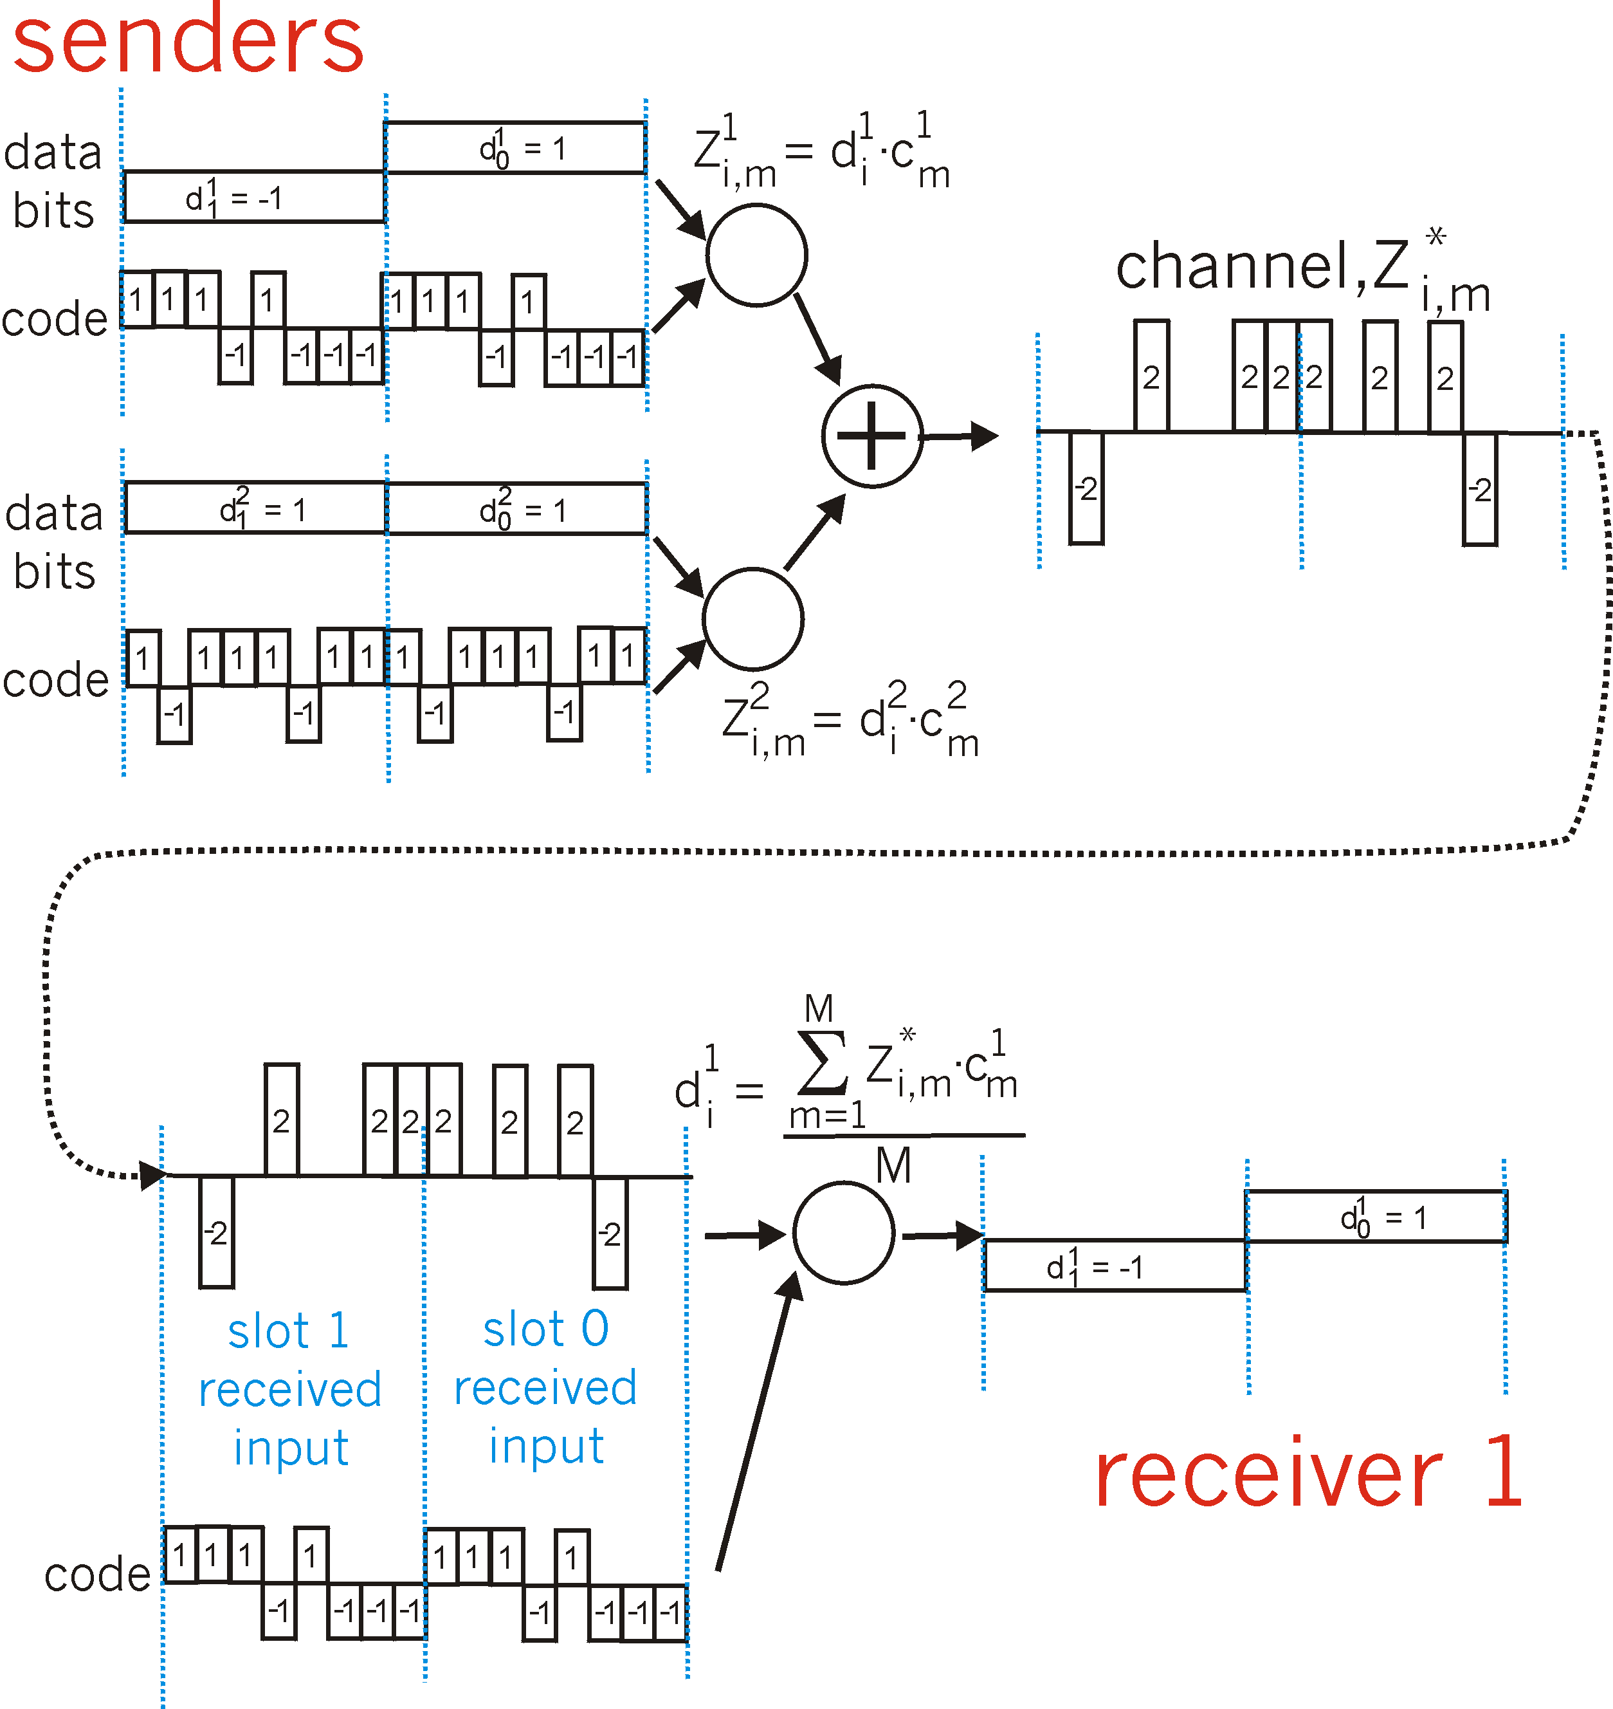
CDMA: two-sender interference
channel sums together transmissions by sender 1 and 2
Sender 1
Sender 2
using same code as sender 1, receiver recovers sender 1’s original data from summed channel data!
… now that’s useful!

Slide 37
Chapter 7 outline
Introduction
Wireless
Wireless links and network characteristics
WiFi: 802.11 wireless LANs
Cellular networks: 4G and 5G
Mobility
Mobility management: principles
Mobility management: practice
4G/5G networks
Mobile IP
Mobility: impact on higher-layer protocols

Slide 38
4G/5G cellular networks
the solution for wide-area mobile Internet
widespread deployment/use:
more mobile-broadband-connected devices than fixed-broadband-connected devices devices (5-1 in 2019)!
4G availability: 97% of time in Korea (90% in US)
transmission rates up to 100’s Mbps
technical standards: 3rd Generation Partnership Project (3GPP)
wwww.3gpp.org
4G: Long-Term Evolution (LTE)standard

Slide 39
4G/5G cellular networks
similarities to wired Internet
edge/core distinction, but both below to same carrier
global cellular network: a network of networks
widespread use of protocols we’ve studied: HTTP, DNS, TCP, UDP, IP, NAT, separation of data/control planes, SDN, Ethernet, tunneling
interconnected to wired Internet
differences from wired Internet
different wireless link layer
mobility as a 1st class service
user “identity” (via SIM card)
business model: users subscribe to a cellular provider
strong notion of “home network” versus roaming on visited nets
global access, with authentication infrastructure, and inter-carrier settlements

Slide 40

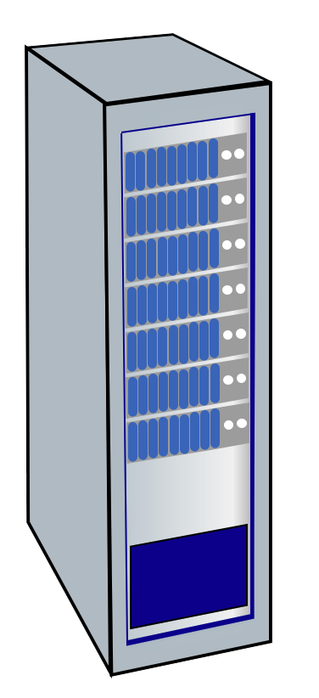




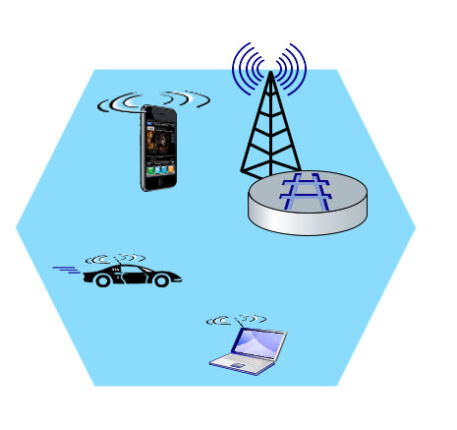
Elements of 4G LTE architecture
Mobile device:
smartphone, tablet, laptop, IoT, ... with 4G LTE radio
64-bit International Mobile Subscriber Identity (IMSI), stored on SIM (Subscriber Identity Module) card
LTE jargon: User Equipment (UE)
Mobility Management Entity (MME)
Home Subscriber Service (HSS)
Mobile device
(UE)
Base station
(eNode-B)
to
Internet
PDN gateway (P-GW)
…
Serving Gateway (S-GW)
radio access
network
all-IP Enhanced Packet Core (EPC)

Slide 41
Elements of 4G LTE architecture
Base station:
at “edge” of carrier’s network
manages wireless radio resources, mobile devices in its coverage area (“cell”)
coordinates device authentication with other elements
similar to WiFi AP but:
active role in user mobility
coordinates with nearly base stations to optimize radio use
LTE jargon: eNode-B
Mobility Management Entity (MME)
Home Subscriber Service (HSS)
Mobile device
(UE)
Base station
(eNode-B)
to
Internet
PDN gateway (P-GW)
…
Serving Gateway (S-GW)

Slide 42
Elements of 4G LTE architecture
Home Subscriber Service
stores info about mobile devices for which the HSS’s network is their “home network”
works with MME in device authentication
Mobility Management Entity (MME)
Home Subscriber Service (HSS)
Mobile device
(UE)
Base station
(eNode-B)
to
Internet
PDN gateway (P-GW)
…
Serving Gateway (S-GW)

Slide 43
Elements of 4G LTE architecture
Serving Gateway (S-GW), PDN Gateway (P-GW)
lie on data path from mobile to/from Internet
P-GW
gateway to mobile cellular network
Looks like nay other internet gateway router
provides NAT services
other routers:
extensive use of tunneling
Mobility Management Entity (MME)
Home Subscriber Service (HSS)
Mobile device
(UE)
Base station
(eNode-B)
to
Internet
PDN gateway (P-GW)
…
Serving Gateway (S-GW)

Slide 44
Elements of 4G LTE architecture
Mobility Management Entity
device authentication (device-to-network, network-to-device) coordinated with mobile home network HSS
Mobility Management Entity (MME)
Home Subscriber Service (HSS)
Mobile device
(UE)
Base station
(eNode-B)
to
Internet
PDN gateway (P-GW)
mobile device management:
device handover between cells
tracking/paging device location
path (tunneling) setup from mobile device to P-GW
…
Serving Gateway (S-GW)

Slide 45
LTE: data plane control plane separation
control plane
new protocols for mobility management , security, authentication (later)
HSS
base station
MME
P-GW
S-GW
data plane
new protocols at link, physical layers
base station
S-GW
P-GW
extensive use of tunneling to facilitate mobility
IP tunnels

Slide 46
LTE data plane protocol stack: first hop
LTE link layer protocols:
Packet Data Convergence: header compression, encryption
Radio Link Control (RLC) Protocol: fragmentation/reassembly, reliable data transfer
Medium Access: requesting, use of radio transmission slots
Application
Transport
IP
IP
Packet Data
Convergence
Packet Data
Convergence
Link
Radio Link
Radio Link
Medium Access
Medium Access
Physical
Physical
data
plane
base station
S-GW
P-GW

Slide 47
LTE data plane protocol stack: first hop
LTE radio access network:
downstream channel: FDM, TDM within frequency channel (OFDM - orthogonal frequency division multiplexing)
“orthogonal”: minimal interference between channels
upstream: FDM, TDM similar to OFDM
each active mobile device allocated two or more 0.5 ms time slots over 12 frequencies
scheduling algorithm not standardized – up to operator
100’s Mbps per device possible
Application
Transport
IP
IP
Packet Data
Convergence
Packet Data
Convergence
Link
Radio Link
Radio Link
Medium Access
Medium Access
Physical
Physical
base station

Slide 48
LTE data plane protocol stack: packet core
tunneling:
mobile datagram encapsulated using GPRS Tunneling Protocol (GTP), sent inside UDP datagram to S-GW
S-GW re-tunnels datagrams to P-GW
supporting mobility: only tunneling endpoints change when mobile user moves
GTP-U
GTP-U
GTP-U
UDP
UDP
UDP
IP
IP
IP
IP
Packet Data
Convergence
Radio Link
link
link
link
Medium Access
Physical
Physical
Physical
Physical
\
base station
S-GW
P-GW

Slide 49
LTE data plane: associating with a BS
1
2
3
data
plane
base station
S-GW
P-GW
1
BS broadcasts primary synch signal every 5 ms on all frequencies
BSs from multiple carriers may be broadcasting synch signals
2
mobile finds a primary synch signal, then locates 2nd synch signal on this freq.
mobile then finds info broadcast by BS: channel bandwidth, configurations; BS’s cellular carrier info
mobile may get info from multiple base stations, multiple cellular networks
3
mobile selects which BS to associate with (e.g., preference for home carrier)
4
more steps still needed to authenticate, establish state, set up data plane

Slide 50
LTE mobiles: sleep modes
ZZZZ...
data
plane
as in WiFi, Bluetooth: LTE mobile may put radio to “sleep” to conserve battery:
light sleep: after 100’s msec of inactivity
wake up periodically (100’s msec) to check for downstream transmissions
deep sleep: after 5-10 secs of inactivity
mobile may change cells while deep sleeping – need to re-establish association

Slide 51
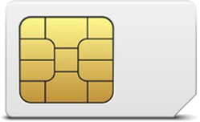
Global cellular network: a network of IP networks
home network HSS:
identify & services info, while in home network and roaming
Home
Subscriber
Server
home mobile
carrier network
P-GW
public Internet
and
inter-carrier IPX
all IP:
carriers interconnect with each other, and public internet at exchange points
legacy 2G, 3G: not all IP, handled otherwise
…
…
in home network
P-GW
SIM card: global identify info in home network
visited mobile
carrier network
…
roaming in visited network

Slide 52
On to 5G!
goal: 10x increase in peak bitrate, 10x decrease in latency, 100x increase in traffic capacity over 4G
5G NR (new radio):
two frequency bands: FR1 (450 MHz–6 GHz) and FR2 (24 GHz–52 GHz): millimeter wave frequencies
not backwards-compatible with 4G
MIMO: multiple directional antennae
millimeter wave frequencies: much higher data rates, but over shorter distances
pico-cells: cells diameters: 10-100 m
massive, dense deployment of new base stations required

Slide 53
Chapter 7 outline
Introduction
Wireless
Wireless links and network characteristics
WiFi: 802.11 wireless LANs
Cellular networks: 4G and 5G
Mobility
Mobility management: principles
Mobility management: practice
Mobile IP
4G/5G networks
Mobility: impact on higher-layer protocols

Slide 54
What is mobility?
spectrum of mobility, from the network perspective:
no mobility
high mobility
device moves
between networks, but
powers down
while moving
device moves within same AP in
one provider
network
device moves among APs in
one provider
network
device moves
among multiple
provider networks,
while maintaining
ongoing connections
We’re interested in these!

Slide 55



Mobility: vocabulary
home network: permanent “home” of mobile
(e.g., 128.119.40/24)
home agent: entity that will perform mobility functions on behalf of mobile, when mobile is remote
wide area network
permanent address: address in home network, can always be used to reach mobile
e.g., 128.119.40.186

Slide 56
Mobility: more vocabulary
permanent address: remains constant (e.g., 128.119.40.186)
visited network: network in which mobile currently resides (e.g., 79.129.13/24)
care-of-address: address in visited network.
(e.g., 79,129.13.2)
wide area network
foreign agent: entity in visited network that performs mobility functions on behalf of mobile.
correspondent: wants to communicate with mobile

Slide 57

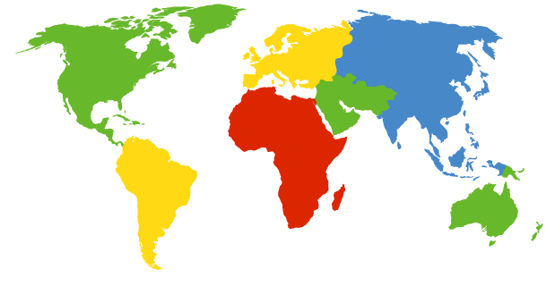

How do you contact a mobile friend:
Consider friend frequently changing addresses, how do you find her?
I wonder where Alice moved to?
search all phone books?
call her parents?
expect her to let you know where he/she is?
Facebook!

Slide 58
Mobility approaches
let network (routers) handle it:
routers advertise well-known name, address (e.g., permanent 32-bit IP address), or number (e.g., cell #) of visiting mobile node via usual routing table exchange
Internet routing could do this already with no changes! Routing tables indicate where each mobile located via longest prefix match!

Slide 59
Mobility approaches
let network (routers) handle it:
routers advertise well-known name, address (e.g., permanent 32-bit IP address), or number (e.g., cell #) of visiting mobile node via usual routing table exchange
Internet routing could do this already with no changes! Routing tables indicate where each mobile located via longest prefix match!
not
scalable
to billions of
mobiles
let end-systems handle it: functionality at the “edge”
indirect routing: communication from correspondent to mobile goes through home network, then forwarded to remote mobile
direct routing: correspondent gets foreign address of mobile, send directly to mobile

Slide 60
Mobility: registration
visited network
home network
1
2
wide area network
mobile contacts foreign agent on entering visited network
foreign agent contacts home agent home: “this mobile is resident in my network”
end result:
foreign agent knows about mobile
home agent knows location of mobile

Slide 61

Mobility via indirect routing
foreign agent receives packets, forwards to mobile
home agent intercepts packets, forwards to foreign agent
visited
network
home
network
3
wide area network
2
1
correspondent addresses packets using home address of mobile
4
mobile replies directly to correspondent

Slide 62



Indirect Routing: comments
mobile uses two addresses:
permanent address: used by correspondent (hence mobile location is transparent to correspondent)
care-of-address: used by home agent to forward datagrams to mobile
foreign agent functions may be done by mobile itself
triangle routing: correspondent-home-network-mobile
inefficient when
correspondent, mobile
are in same network

Slide 63
Indirect routing: moving between networks
suppose mobile user moves to another network
registers with new foreign agent
new foreign agent registers with home agent
home agent update care-of-address for mobile
packets continue to be forwarded to mobile (but with new care-of-address)
mobility, changing foreign networks transparent: on going connections can be maintained!

Slide 64


Mobility via direct routing
foreign agent receives packets, forwards to mobile
correspondent forwards to foreign agent
visited
network
home
network
3
1
2
4
correspondent requests, receives foreign address of mobile
mobile replies directly to correspondent

Slide 65




Mobility via direct routing: comments
overcome triangle routing problem
non-transparent to correspondent: correspondent must get care-of-address from home agent
what if mobile changes visited network?
3
1
2
4

Slide 66


Accommodating mobility with direct routing
anchor foreign agent: FA in first visited network
data always routed first to anchor FA
when mobile moves: new FA arranges to have data forwarded from old FA (chaining)
foreign net visited
at session start
anchor
foreign
agent
wide area network
2
1
4
5
3
new
foreign
network
correspondent
agent
new foreign
agent
correspondent

Slide 67
Chapter 7 outline
Introduction
Wireless
Wireless links and network characteristics
WiFi: 802.11 wireless LANs
Cellular networks: 4G and 5G
Mobility
Mobility management: principles
Mobility management: practice
Mobile IP
4G/5G networks
Mobility: impact on higher-layer protocols

Slide 68
Mobile IP
RFC 3344
has many features we’ve seen:
home agents, foreign agents, foreign-agent registration, care-of-addresses, encapsulation (packet-within-a-packet)
three components to standard:
indirect routing of datagrams
agent discovery
registration with home agent

Slide 69

Mobile IP: Indirect Routing
foreign-agent-to-mobile packet
packet sent by home agent to foreign agent: a packet within a packet
dest: 128.119.40.186
dest: 79.129.13.2
dest: 128.119.40.186
Permanent address: 128.119.40.186
Care-of address: 79.129.13.2
dest: 128.119.40.186
packet sent by correspondent

Slide 70
Mobile IP: agent discovery
agent advertisement: foreign/home agents advertise service by broadcasting ICMP messages (typefield = 9)
H,F bits: home and/or foreign agent
R bit: registration required

Slide 71
Mobile IP: registration example
visited network: 79.129.13/24
home agent
HA: 128.119.40.7
foreign agent
COA: 79.129.13.2
mobile agent
MA: 128.119.40.186
ICMP agent adv.
COA: 79.129.13.2
….
registration req.
registration req.
COA: 79.129.13.2
HA: 128.119.40.7
MA: 128.119.40.186
Lifetime: 9999
identification: 714
encapsulation format
….
COA: 79.129.13.2
HA: 128.119.40.7
MA: 128.119.40.186
Lifetime: 9999
identification:714
….
registration reply
HA: 128.119.40.7
MA: 128.119.40.186
Lifetime: 4999
Identification: 714
encapsulation format
….
registration reply
HA: 128.119.40.7
MA: 128.119.40.186
Lifetime: 4999
Identification: 714
….
time

Slide 72
Mobile IP (skipped)
mobile IP architecture standardized ~20 years ago [RFC 5944]
long before ubiquitous smartphones, 4G support for Internet protocols
did not see wide deployment/use
perhaps WiFi for Internet, and 2G/3G phones for voice were “good enough” at the time
mobile IP architecture:
indirect routing to node (via home network) using tunnels
mobile IP home agent: combined roles of 4G HSS and home P-GW
mobile IP foreign agent: combined roles of 4G MME and S-GW
protocols for agent discovery in visited network, registration of visited location in home network via ICMP extensions

Slide 73
What is mobility?
spectrum of mobility, from the network perspective:
no mobility
high mobility
device moves
between networks, but
powers down
while moving
device moves within same AP in
one provider
network
device moves among APs in
one provider
network
device moves
among multiple
provider networks,
while maintaining
ongoing connections
We’re interested in these!

Slide 74
Mobility challenge:
content
provider
network
If a device moves from one network another:
How will the “network” know to forward packets to the new network?
datacenter
network
Verizon
public Internet
sevice moves from Verizon to AT&T
AT&T

Slide 75
Home network, visited network: 4G/5G
home network:
(paid) service plan with cellular provider, e.g., Verizon, Orange
home network HSS stores identify & services info
Home
Subscriber
Server
home mobile
carrier network
P-GW
public Internet
and
inter-carrier IPX
…
…
in home network
visited network:
any network other than your home network
service agreement with other networks: to provide access to visiting mobile
P-GW
SIM card: global identify info including home network
visited mobile
carrier network
…
roaming in visited network

Slide 76
Home network, visited network: ISP/WiFi
ISP/WiFi: no notion of global “home”
credentials from ISP (e.g., username, password) stored on device or with user
ISPs may have national, international presence
different networks: different credentials
some exceptions (e.g., eduroam)
architectures exist (mobile IP) for 4G-like mobility, but not used
authentication
access
server
public Internet
…
…
attach
authentication
access
server
…
attach

Slide 77
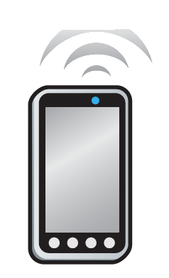

Home network, visited network: generic
Home Network
e.g.,: 128.119/16
Visited Network
e.g.,: 79.129/16
Permanent IP:
128.119.40.186
IMSI
78:4f:43:98:d9:27
Home
Subscriber
Server
NAT IP:
10.0.0.99
IMSI
78:4f:43:98:d9:27
Mobility manager
Mobility manager
Visited network gateway
Home network gateway
Home gateway
public or private Internet
Correspondent

Slide 78
Registration: home needs to know where you are!
Home Network
e.g.,: 128.119/16
Visited Network
e.g.,: 79.129/16
1
mobile associates with visited mobility manager
Permanent IP:
128.119.40.186
IMSI
78:4f:43:98:d9:27
Home
Subscriber
Server
NAT IP:
10.0.0.99
IMSI
78:4f:43:98:d9:27
2
Mobility manager
Visited network gateway
visited mobility manager registers mobile’s location with home HSS
Mobility manager
Home network gateway
Home gateway
public or private Internet
end result:
visited mobility manager knows about mobile
home HSS knows location of mobile

Slide 79
Mobility with indirect routing
Home Network
e.g.,: 128.119/16
Visited Network
e.g.,: 79.129/16
Permanent IP:
128.119.40.186
IMSI
78:4f:43:98:d9:27
Home
Subscriber
Server
NAT IP:
10.0.0.99
IMSI
78:4f:43:98:d9:27
3
Mobility manager
visited gateway router forwards to mobile
2
Mobility manager
4a
Visited network gateway
Home network gateway
Home gateway
home gateway receives datagram, forwards (tunnels) to remote gateway
public or private Internet
1
visited gateway router forwards reply to correspondent via home network (4a) or directly (4b)
4b
correspondent uses home address as datagram destination address
Correspondent

Slide 80
Mobility with indirect routing: comments
triangle routing:
inefficient when correspondent and mobile are in same network
mobile moves among visited networks: transparent to correspondent!
registers in new visited network
new visited network registers with home HSS
datagrams continue to be forwarded from home network to mobile in new network
on-going (e.g., TCP) connections between correspondent and mobile can be maintained!

Slide 81
Mobility with direct routing
Home Network
e.g.,: 128.119/16
Visited Network
e.g.,: 79.129/16
Permanent IP:
128.119.40.186
IMSI
78:4f:43:98:d9:27
Home
Subscriber
Server
NAT IP:
10.0.0.99
IMSI
78:4f:43:98:d9:27
4
Mobility manager
visited gateway router forwards to mobile
Mobility manager
Visited network gateway
Home gateway
2
public or private Internet
3
correspondent contacts home HSS, gets mobile’s visited network
1
Correspondent addresses datagram to visited network address
Correspondent

Slide 82
Mobility in 4G networks: major mobility tasks
1
base station association:
covered earlier
mobile provides IMSI – identifying itself, home network
Mobility manager
Home
Subscriber
Server
2
1
MME
Home
network
3
base station
P-GW
S-GW
4
2
control-plane configuration:
MME, home HSS establish control-plane state - mobile is in visited network
Internet
P-GW
Visited network
Streaming server
3
data-plane configuration:
MME configures forwarding tunnels for mobile
visited, home network establish tunnels from home P-GW to mobile
4
mobile handover:
mobile device changes its point of attachment to visited network

Slide 83
Configuring LTE control-plane elements
Mobility manager
Home
Subscriber
Server
2
MME
Home
network
base station
P-GW
P-GW
S-GW
Visited network
Mobile communicates with local MME via BS control-plane channel
MME uses mobile’s IMSI info to contact mobile’s home HSS
retrieve authentication, encryption, network service information
home HHS knows mobile now resident in visited network
BS, mobile select parameters for BS-mobile data-plane radio channel

Slide 84
Configuring data-plane tunnels for mobile
Mobility manager
S-GW to BS tunnel: when mobile changes base stations, simply change endpoint IP address of tunnel
S-GW to home P-GW tunnel: implementation of indirect routing
Home
Subscriber
Server
MME
Home
network
base station
P-GW
S-GW
Internet
P-GW
Visited network
Streaming server
tunneling via GTP (GPRS tunneling protocol): mobile’s datagram to streaming server encapsulated using GTP inside UDP, inside datagram

Slide 85
Handover between BSs in same cellular network
data path before handover
source BS
1
current (source) BS selects target BS, sends Handover Request message to target BS
3
S-GW
1
4
2
P-GW
2
target BS pre-allocates radio time slots, responds with HR ACK with info for mobile
data path after
handover
MME
target BS
3
source BS informs mobile of new BS
mobile can now send via new BS - handover looks complete to mobile
4
source BS stops sending datagrams to mobile, instead forwards to new BS (who forwards to mobile over radio channel)

Slide 86
Handover between BSs in same cellular network
source BS
3
S-GW
1
4
5
target BS informs MME that it is new BS for mobile
MME instructs S-GW to change tunnel endpoint to be (new) target BS
2
6
P-GW
5
7
5
MME
target BS
6
target BS ACKs back to source BS: handover complete, source BS can release resources
7
mobile’s datagrams now flow through new tunnel from target BS to S-GW

Slide 87
Handover is effective to support mobility in cellular networks,
But, is it that simple?
Check recent research done my group, https://www.cs.purdue.edu/homes/chunyi/
HotMobile’24, CoNext’23, MobiCom’23, INFOCOM’23, ICNP’21, MobiCom’20, SIGMETICS’16 …

Slide 88
Wireless, mobility: impact on higher layer protocols
logically, impact should be minimal …
best effort service model remains unchanged
TCP and UDP can (and do) run over wireless, mobile
… but performance-wise:
packet loss/delay due to bit-errors (discarded packets, delays for link-layer retransmissions), and handover loss
TCP interprets loss as congestion, will decrease congestion window un-necessarily
delay impairments for real-time traffic
bandwidth a scare resource for wireless links

Slide 89
Chapter 7 summary
Wireless
Wireless Links and network characteristics
WiFi: 802.11 wireless LANs
Cellular networks: 4G and 5G
Mobility
Mobility management: principles
Mobility management: practice
Mobile IP
4G/5G networks
Mobility: impact on higher-layer protocols

